Slide 2
Final Variables
If you don't want others (or yourself) to overwrite existing values, use the final keyword (this will declare the variable as "final" or "constant", which means unchangeable and read-only)
final int myNum = 15;
myNum = 20; // will generate an error: cannot assign a value to a final variable

Slide 3
class Final_Var
{
public static void main(String args[])
{
final int a= 20;
a=22;
}
}

Slide 4
How to display variables?
class Display_var
{
public static void main(String args[])
{
String fName = "SIT ";
String lName = "College";
//Concatenates two variables
String fullName = fName+ lName; System.out.println(fullName);
int x = 5;
int y = 6;
// Print the value of x + y
System.out.println(x + y);
//Declare Many Variables
int a=66,b=45,c=6;
System.out.println(a+b+c);
}//end of main
}//end pf class

Slide 5
Java Identifiers
All Java variables must be identified with unique names.
These unique names are called identifiers.
The general rules for naming variables are:
Names can contain letters, digits, underscores, and dollar signs
Names must begin with a letter
Names should start with a lowercase letter, and cannot contain whitespace
Names can also begin with $ and _
Names are case-sensitive ("myVar" and "myvar" are different variables)
Reserved words (like Java keywords, such as int or boolean) cannot be used as names

Slide 6
// Student data
String studentName = “Rakesh Deo";
int studentID = 15;
int studentAge = 23;
float studentFee = 75.25f;
char studentGrade = 'B';
// Print variables
System.out.println("Student name: " + studentName);
System.out.println("Student id: " + studentID);
System.out.println("Student age: " + studentAge);
System.out.println("Student fee: " + studentFee);
System.out.println("Student grade: " + studentGrade);

Slide 7
Calculate the Area of a Rectangle
// Create integer variables
int length = 4;
int width = 6;
int area;
// Calculate the area of a rectangle
area = length * width;
// Print variables
System.out.println("Length is: " + length);
System.out.println("Width is: " + width);
System.out.println("Area of the rectangle is: " + area);

Slide 8
Java Type Casting
Type casting is when you assign a value of one primitive data type to another type.
Widening Casting (automatically) - converting a smaller type to a larger type size.
Narrowing Casting (manually) - converting a larger type to a smaller size type.

Slide 9
Widening Casting
public class TCast {
public static void main(String[] args) {
int myInt = 9;
double myDouble = myInt; // Automatic casting: int to double
System.out.println(myInt); // Outputs 9
System.out.println(myDouble); // Outputs 9.0
}
}

Slide 10
Narrowing Casting
public class Ncast {
public static void main(String[] args) {
double myDouble = 9.78d;
int myInt = (int) myDouble; // Manual casting: double to int
System.out.println(myDouble); // Outputs 9.78
System.out.println(myInt); // Outputs 9
}

Slide 11
Java Operators
Java Operators
Operators are used to perform operations on variables and values.
Java divides the operators into the following groups:
Arithmetic operators
Assignment operators
Comparison operators
Logical operators
Bitwise operators

Slide 12
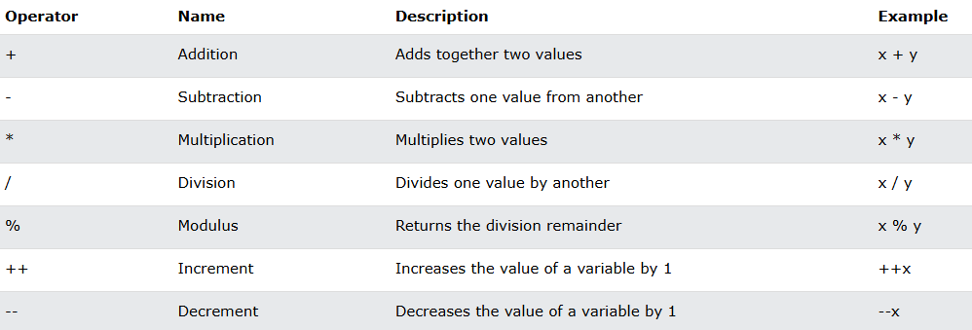
Arithmetic operators

Slide 13
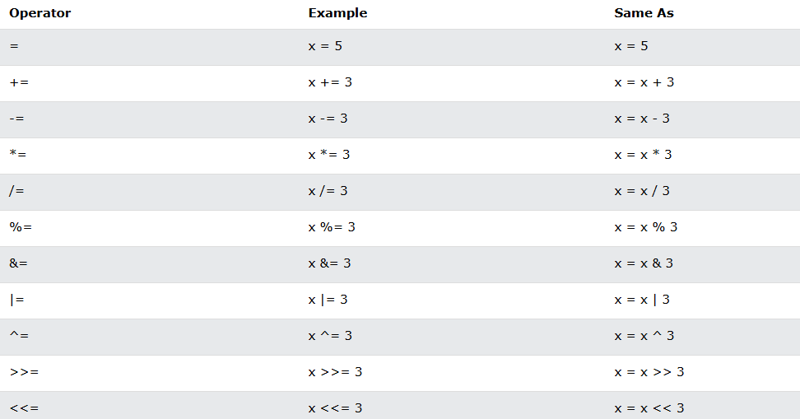
Assignment operators

Slide 14
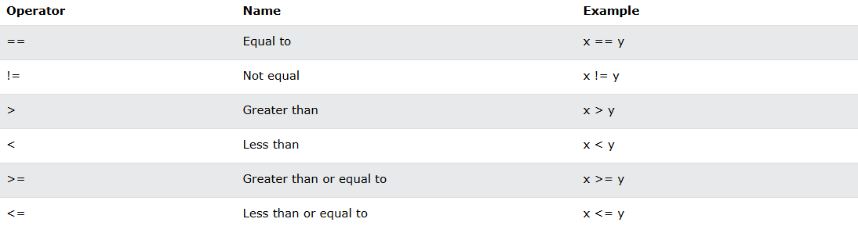
Comparison operators
This is important in programming, because it helps us to find answers and make decisions. The return value of a comparison is either true or false. These values are known as Boolean values.

Slide 15
class MyComparisonOperator
{
public static void main(String args[])
{
int x = 5;
int y = 3;
System.out.println(x > y); // returns true, because 5 is higher than 3
}
}

Slide 16
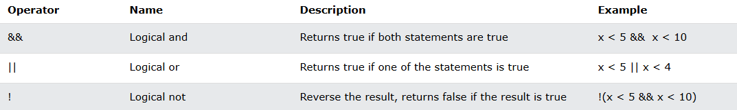
Logical operators

Slide 17
public class MyLogicalOperatopr
{
public static void main(String[] args)
{
int x = 5;
int y = 3;
System.out.println(x == y); // returns false because 5 is not equal to 3
}
}

Slide 18
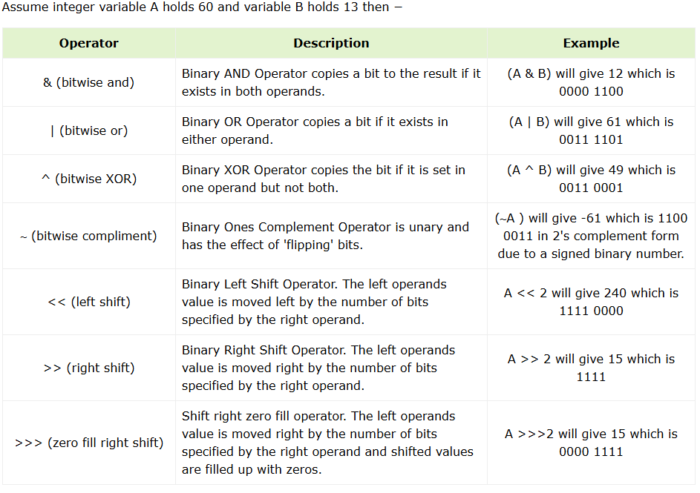
Bitwise operators

Slide 19
public class Test
{
public static void main(String args[])
{
int a = 60; /* 60 = 0011 1100 */
int b = 13; /* 13 = 0000 1101 */
int c = 0;
c = a & b; /* 12 = 0000 1100 */
System.out.println("a & b = " + c );
c = a | b; /* 61 = 0011 1101 */
System.out.println("a | b = " + c );
}
}

Slide 20
Miscellaneous Operators
Conditional Operator ( ? : )
instanceof Operator

Slide 21
Conditional Operator ( ? : )
Conditional operator is also known as the ternary operator. This operator consists of three operands and is used to evaluate Boolean expressions. The goal of the operator is to decide, which value should be assigned to the variable.
Syntax
variable x = (expression) ? value if true : value if false

Slide 22
public class Test
{
public static void main(String args[])
{
int a, b;
a = 10;
b = (a == 1) ? 20: 30;
System.out.println( "Value of b is : " + b );
b = (a == 10) ? 20: 30;
System.out.println( "Value of b is : " + b );
}
}

Slide 23
instanceof Operator
This operator is used only for object reference variables. The operator checks whether the object is of a particular type (class type or interface type).
Syntax
( Object reference variable ) instanceof (class/interface type)

Slide 24
public class Test
{
public static void main(String args[])
{
String name = “SIT";
// following will return true since name is type of String
boolean result = name instanceof String;
System.out.println( result );
}
}

Slide 25
User Input in Java
To take input from the user in Java, the Scanner class is used. The Scanner class a built-in class of java.util package.
Java Scanner class provides many built-in methods to take different types of user inputs from the users.
How to Use Scanner Class to Take User Input?

Slide 26
How to Use Scanner Class to Take User Input?
Step 1 : Import Scanner Class
First you need to import the Scanner class to use its methods. To
import the Scanner class, use the following import statement −
import java.util.Scanner
Step 2: Create Scanner Class's Object
After importing the Scanner class, you need to create its object to use
its methods. To create an object of the Scanner class, invoke
Scanner() constructor.
Scanner obj = new Scanner(System.in);

Slide 27
Step 3: Take User Input
Scanner class provides a variety of methods which are useful to take
user input of different types. For example, if you want to input an
integer value, use nextInt() method.
int age = obj.nextInt();

Slide 28
import java.util.Scanner;
public class AddTwoNumbers
{
public static void main(String[] args)
{
// Creating an object of Scanner class
Scanner sc = new Scanner(System.in);
// Reading two Integer numbers
// using nextInt() method
System.out.print("Enter the first number: ");
int num1 = sc.nextInt();
System.out.print("Enter the second number: ");
int num2 = sc.nextInt();
// Calculating the sum
int sum = num1 + num2;
// Printing the su
System.out.println("The sum of the two numbers is: " + sum);
}
}

Slide 29
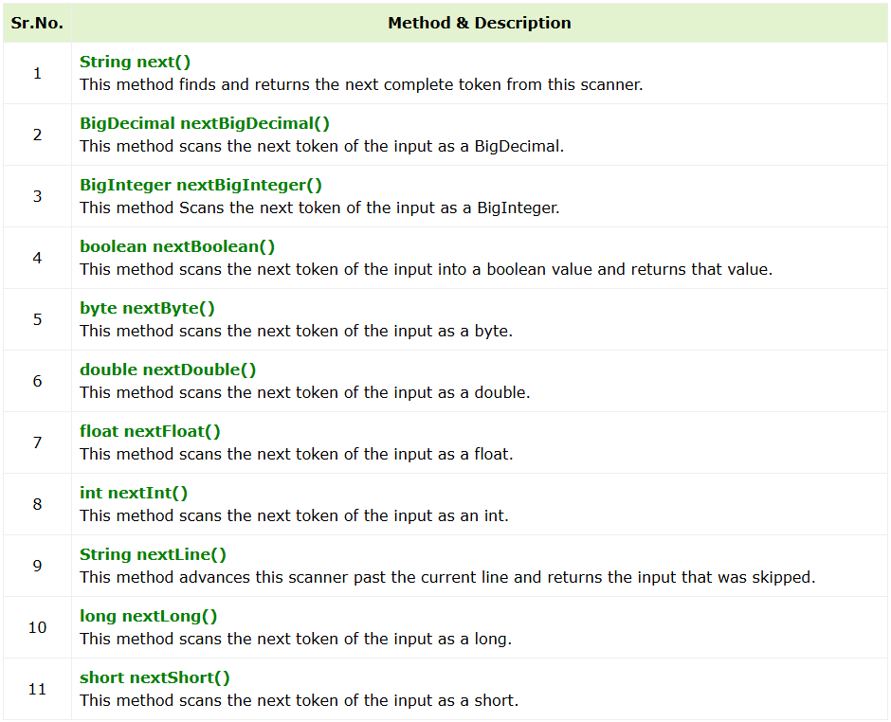

Slide 30
Float Input from the User
The nextFloat() method is used to take input of a float value from the user.
String Input from the User
The nextLine() method is used to take input of a string value from the user.

Slide 31
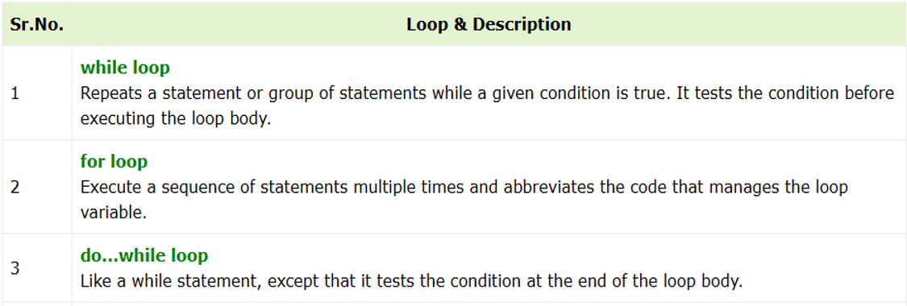
Java Loops

Slide 32
for loop
for (initialExpression; testExpression; updateExpression)
{
// body of the loop
}
The initialExpression initializes and/or declares variables and executes only once.
The condition is evaluated. If the condition is true, the body of the for loop is executed.
The updateExpression updates the value of initialExpression.
The condition is evaluated again. The process continues until the condition is false.

Slide 33
// Program to print a text 5 times
class Main
{
public static void main(String[] args)
{
int n = 5;
// for loop
for (int i = 1; i <= n; ++i)
{
System.out.println("Java is fun");
}//End of for
} //End of main
} //End of Main

Slide 34
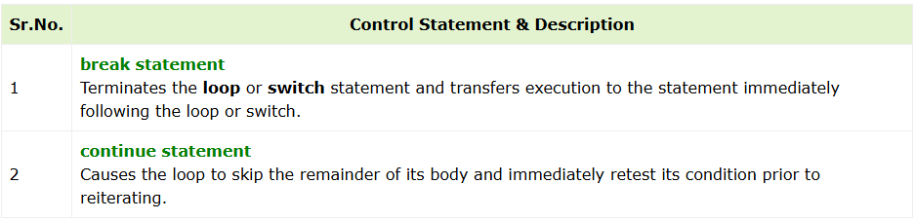
Loop Control Statements
Loop control statements change execution from its normal sequence. When execution leaves a scope, all automatic objects that were created in that scope are destroyed.

Slide 35
Java - Decision Making
Decision making structures have one or more conditions to be evaluated or tested by the program, along with a statement or statements that are to be executed if the condition is determined to be true, and optionally, other statements to be executed if the condition is determined to be false.

Slide 36
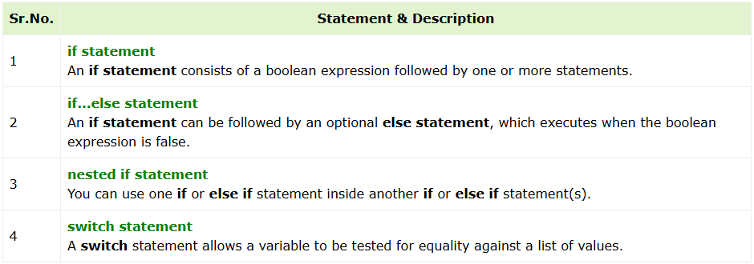

Slide 37
The conditional operator ? : can be used to replace if...else statements.

Slide 38
public class Test {
public static void main(String args[]) {
int x = 30;
if( x < 20 ) {
System.out.print("This is if statement");
}else {
System.out.print("This is else statement");
}
}
}

Slide 39
public class Test {
public static void main(String[] args) {
int x = 10, y = 20, z = 30;
if(x >= y) {
if(x >= z)
System.out.println(x + " is the largest.");
else
System.out.println(z + " is the largest.");
}
else
{
if(y >= z)
System.out.println(y + " is the largest.");
else
System.out.println(z + " is the largest.");
}
}
}

